Slide 1
Google Data Analytics Capstone
Cyclistic Ride-Share Project
Zach Howard

Slide 2
Objective
Increasing members of Cyclistic bike-share program by finding trends and patterns in how casuals & members use the bikes/scooters differently.

Slide 3
Plan
Clean & Transform data.
Analyzing the data to find how casuals & members use the bikes/scooter differently.
Use this information to find locations of casuals that use the bikes/scooters similar to members.
Target these locations with ads/marketing to convert these casual riders to members.

Slide 4
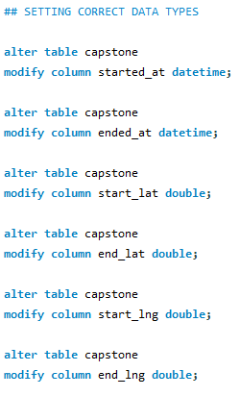
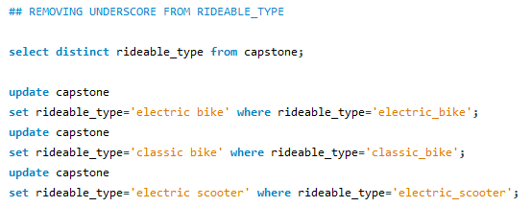
Cleaning & Transforming Data
After importing and aggregating from multiple csv files, I set correct data formats for columns.
Fixed the ride type to make it more readable removing underscore in the data.

Slide 5
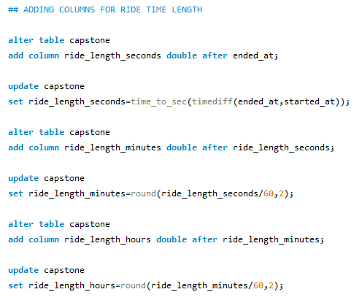
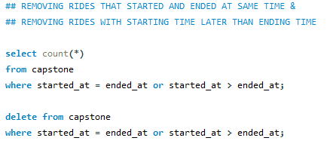
Cleaning & Transforming Data
Taking the columns `started_at` and `ended_at` to create a new column for ride time length in seconds, minutes, and hours.
Removed rows where the start time and end time are the same or start time is after end time.

Slide 6
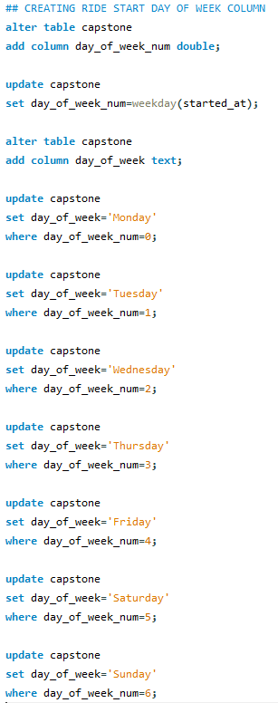
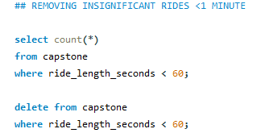
Cleaning & Transforming Data
Created Day of Week column using started_at time date.
Removed insignificant rides that were under 1 minute.

Slide 7
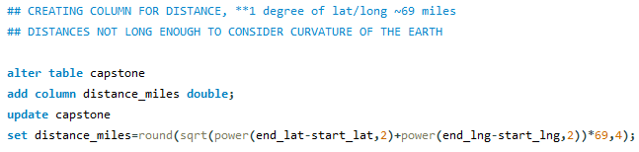
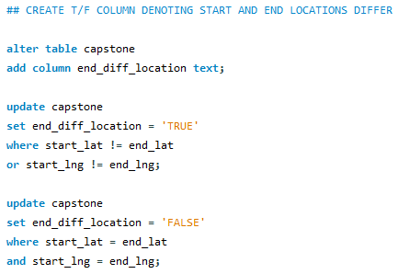
Cleaning & Transforming Data
Created a distance column using starting lat/long and ending lat/long. Distances are short enough that curvature of the earth doesn’t need to be calculated. 1 degree of lat/long is approx. 69 miles.
Lastly a True/False column denoting if the ride started and ended at same location.

Slide 8
Guiding Questions
How do annual members and casual riders use Cyclistic bikes differently?
Which data could be used to target new members?
How can Cyclistic influence casual riders to become members?

Slide 9
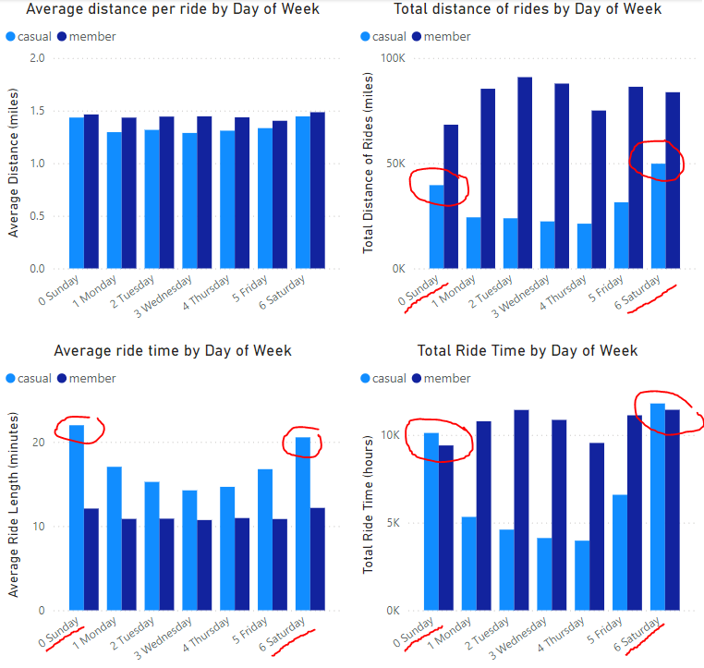
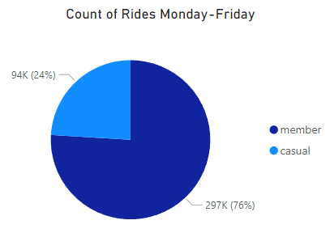
How do annual members and casual riders use Cyclistic bikes differently?
Members are pretty consistent across the week in time and distance ridden.
Casual Members seem to ride more on the weekends both in average time ridden and length ridden.
Members are more likely to ride throughout the week, therefore targeting casuals that ride Monday-Friday would be viable option.
There is a large percentage of casual riders that fit the Monday-Friday model.

Slide 10
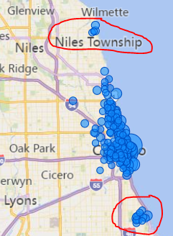
Data that can be used for targeting new members
Casual riders would be more apt to buy an annual membership if they ride consistently Monday-Friday.
This is a map detailing casual users that ride Monday-Friday with a total ride length of 30 miles or more.
These two clusters would be viable options for targeted marketing.

Slide 11
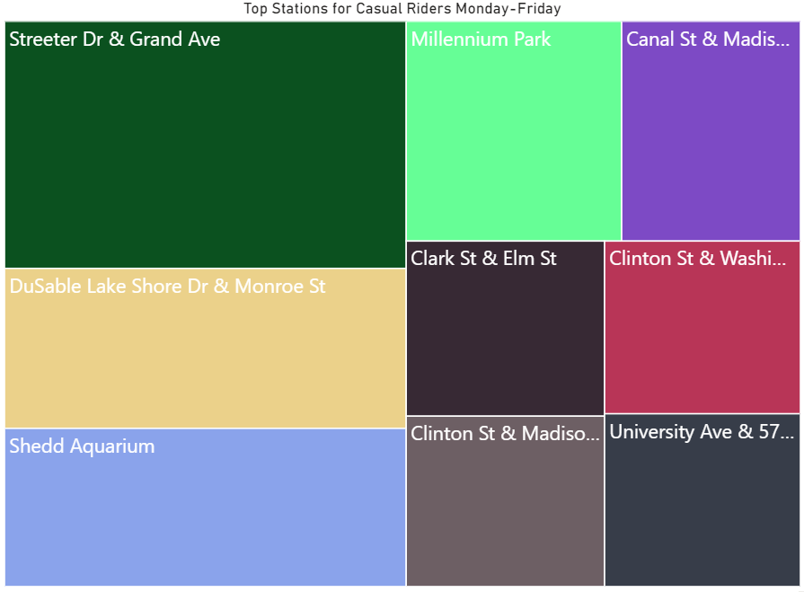
Data that can be used for targeting new members
Casual riders would be more apt to buy an annual membership if they ride consistently Monday-Friday.
This Treemap displays the stations that have the highest amount of casual riders Monday-Friday. Another option for targeted marketing.

Slide 12
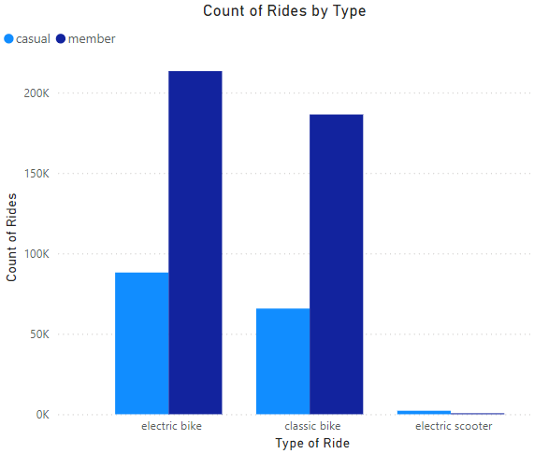
Data that can be used for targeting new members
There doesn’t seem to be a big difference in how casuals and members use the bikes, however the electric scooter usage is relatively nonexistent.
No data in this set points to why the scooters aren’t being used, but increasing scooter usage may be an avenue the company should explore.

Slide 13
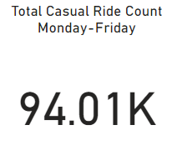
How can Cyclistic influence casual riders to become members?
Targeting the casual users that ride Monday-Friday with new member incentives would be ideal.
Adjusting member price subscriptions to make it more cost-efficient for the casuals that are riding consistently through the week.
For example, using arbitrary numbers, if a day pass is $5 and a member pass is $50/year, the casuals that ride consistently are more apt to get the year as only ten rides covers cost. Finding that right pricing ratio would convert these casuals.
There are a total of 94k casual rides that occurred Monday-Friday.
With the data given there is no way to know how many of these are repeat users. However this is still a large potential for new members.

Slide 14
Recommendations
Casual riders would be more apt to buy an annual membership if they ride consistently Monday-Friday.
Target areas on the cluster map for high casual riders Monday-Friday.
Target the top stations for casual riders Monday-Friday.
Research why scooters are not being used.
Develop a price ratio that would encourage daily Monday-Friday casuals to convert.

